Slide 1
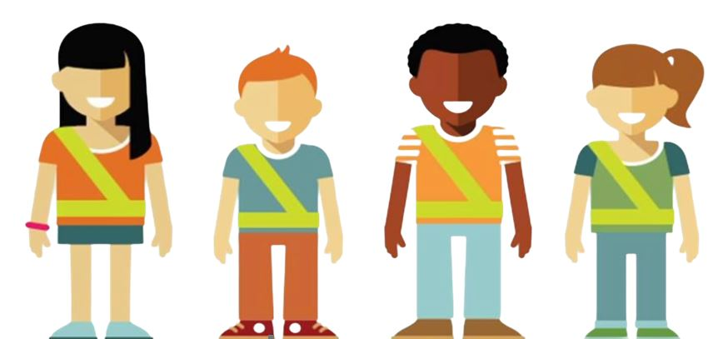
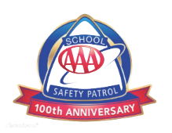
AAA School Safety Patrol Program Introduction

Slide 2
*Presenter Notes*
**Prior to presenting, locate this slide on the left menu,
right click on the slide and select “Hide Slide” **
This presentation is intended to be used by SCHOOL SAFETY PATROL ADVISORS to present to the highest grade level of the school to introduce prospective students to the AAA School Safety Patrol Program.
This presentation includes:
Program overview
History
Years in operation
Expectations of a Patroller
Instructions for applying
Please note slide 11, is for adding your school application information

Slide 3
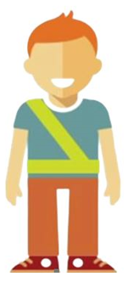
What is the
AAA School Safety Patrol
A group of students who create a safer school environment by identifying safety hazards
Patrollers oversee arrival and dismissal from their assigned posts throughout the school
Notes:
The AAA School Safety Patrol Program is a peer leadership program that schools implement to keep their students safe.

Slide 4
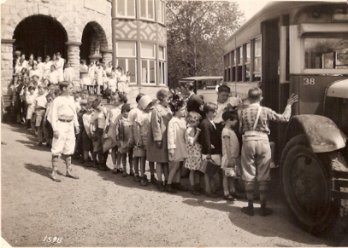
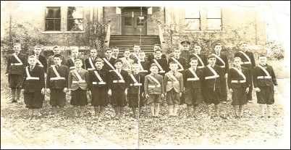
History of the Program
The first AAA School Safety Patrol was formed in Chicago in 1920
Charles M. Hayes was president of the Chicago Motor Club
Several school children struck and killed by a speeding motorist
In the beginning girls were not allowed to participate
The first AAA School Safety Patrol was formed in Chicago in 1920
Charles M. Hayes was president of the Chicago Motor Club
Several school children struck and killed by a speeding motorist
In the beginning girls were not allowed to participate
Notes:
The AAA School Safety Patrol Program began in 1920 by Charles M. Hayes. Back then cars were just becoming more affordable for the average person and were becoming more present on the roads. Since cars were so new, the roads were still built for horses and did not look like our roads today. Drivers and pedestrians were still unaware of the dangers of sharing the road. One day a group of school children were walking home from school when they were struck and killed by a speeding motorist. Charles M. Hayes, the president of the Chicago Motor Club started the first AAA School Safety Patrol Program and promised to make sure this would not happen to children again. In the beginning girls were not allowed to participate however, today all students are welcome to apply to become a Safety patroller.

Slide 5
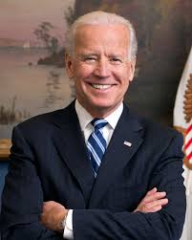
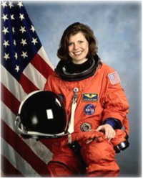
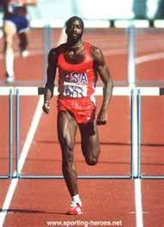
Famous Patrollers
Many important figures in U.S. history gained their first leadership experience as a AAA School Safety Patroller
U.S. Presidents
Vice Presidents
Supreme Court Justices
Nobel Prize Winners
Governors
Senators
Olympic Gold Medalists
Astronauts
Notes:
Pictured: Joe Biden, Edwin Moses, Mary Ellen Weber
The AAA School Safety Patrol is about being a good leader and willing to work hard to help others. Many important individuals throughout our history started their first leadership position as a AAA School Safety Patroller.
AAA School Safety Patrol Famous Former Patrol Members
For some, being a member of the AAA School Safety Patrol is just the first step toward a career of public service and leadership. Former patrol members include:
Governors and Former Governors Bob Martinez, Florida James Blanchard, Michigan William Milliken, Michigan Lincoln Almond, Rhode Island
21 Astronauts, including: Norman E. Thagard, space endurance record holder Robert D. Cabana Mary Ellen Weber
U.S. Presidents/Vice Presidents Jimmy Carter, Bill Clinton, Joe Biden
U.S. Senator John W. Warner, Virginia
U.S. Supreme Court Justices & Former Justices Chief Justice Warren E. Burger, Anthony M. Kennedy, Stephen G. Breyer, Clarence Thomas, William J. Brennan, Jr.
Olympic Gold Medalists Caitlyn Jenner, decathlon Lynette Woodard, basketball Mike Ramsey, hockey Eric Heiden, speedskating Edwin Moses, track and field
Nobel Prize Winner Dr. Gary S. Becker, Economics
Government Andrew Card, Chief of Staff to George H. Bush and George W. Bush and former U.S. Secretary of Transportation U.S. Coast Guard Rear Admiral James C. Card, Office of Marine Safety,
Security and Environmental Protection Diane Steed, former administrator National Highway Traffic Safety Admin. Mike McCurry, former White House Press Secretary
Celebrities Joe Garagiola, Baseball Hall of Famer Tom Seaver, Baseball Hall of Famer Margaret Ay, Miss America 1954 Al Kaline, Baseball Hall of Famer Lee Iacocca, former Chairman Chrysler Corporation

Slide 6
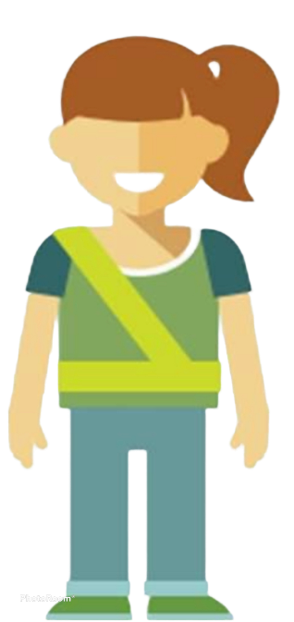
The AAA School
Safety Patrol Today
For over 100 years, the AAA School Safety Patrol program has kept school children safe. Today, more than 679,000 Patrollers continue this legacy throughout schools nationwide.
Notes:
It is important to note that not only are Patrollers representing their school and community but the entire AAA School Safety Patrol program across the country. They are a part of something big!

Slide 7
Typical Patroller Roles
(Varies by school)
AAA School Safety Patrollers direct children, not traffic.
Typical roles include:
Teaching other students about traffic safety on a peer-to-peer basis
Serving as role models for younger children
Standing duty in hallways and at doorways to ensure students aren’t pushing or running
Assisting younger students in getting to class safely
Helping car riders enter/exit their family vehicles safely
Serving as extra eyes and ears for safety on school buses

Slide 8
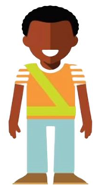
A Great Patroller
Positively represents their school and community
Is willing to work hard to help others
Leads by example
Earns respect by being consistent and fair

Slide 9
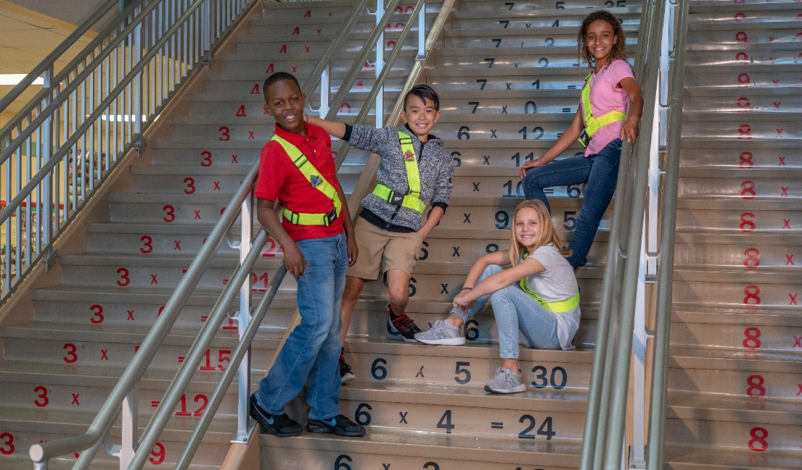
Patrollers Respect
Their Job By
Always reporting for duty on time
Consistently staying alert and looking for safety hazards
Understanding and practicing safe habits
NEVER becoming involved with vehicles
Notes:
If a student is late to their post, an emergency or unsafe situation could occur and they will not be there to assist.
When on duty, paying attention at their post is the most important way to excel at their job. Turning their back to the students and talking to a friend while on duty is not a good example of what to do.
It’s important to ALWAYS practice safe habits as a Patroller on and off duty.
Patrollers should NEVER engage with traffic such as waving on a car in a drop off line, telling a bus driver to go, etc.

Slide 10
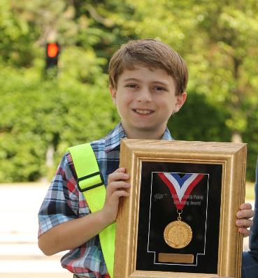
“One of the proudest moments in my life came when I was given a white canvas belt and a tin badge and sworn in as a school boy patrolman.”
-Jimmy Carter (Former U.S. President)
Notes:
Former US President Jimmy Carter was quoted saying, “One of the proudest moments in my life came when I was given a white canvas belt and a tin badge and sworn in as a school boy patrolman. Even with all of the pride that comes with being President of the United States, becoming a AAA School Safety Patroller was one of the proudest moments in his life.

Slide 11
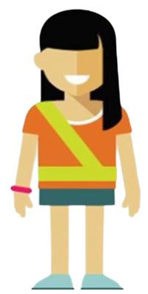
How to Apply
*INSERT YOUR SCHOOL SPECIFIC APPLICATION INFORMATION HERE*
Notes:
Sample application can be found on our website resources: https://cluballiance.aaa.com/traffic-safety/school-safety-patrol?rdl=midatlantic.aaa.com

Slide 12
Questions?
Applications are due on_________. Submit to ____________________.
Date
Advisor/Office/Counselor/Etc.

